Slide 1
eclipse
A Java Integrated Development Environment

Slide 2
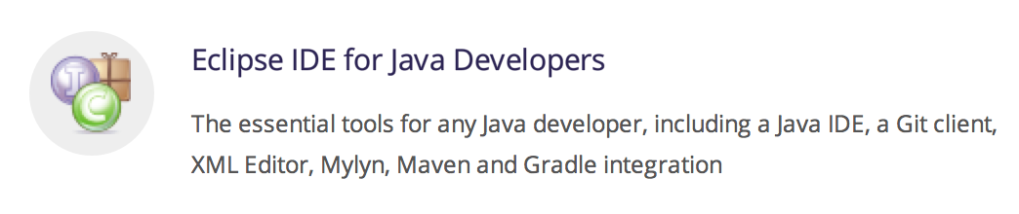
> Start
In class we'll use the eclipse that's installed, but at home…
Download the eclipse installer from https://eclipse.org/
Unpack and run the installer
Select:
(I installed mine to /Applications/eclipse/java-neon)
Launch

Slide 3
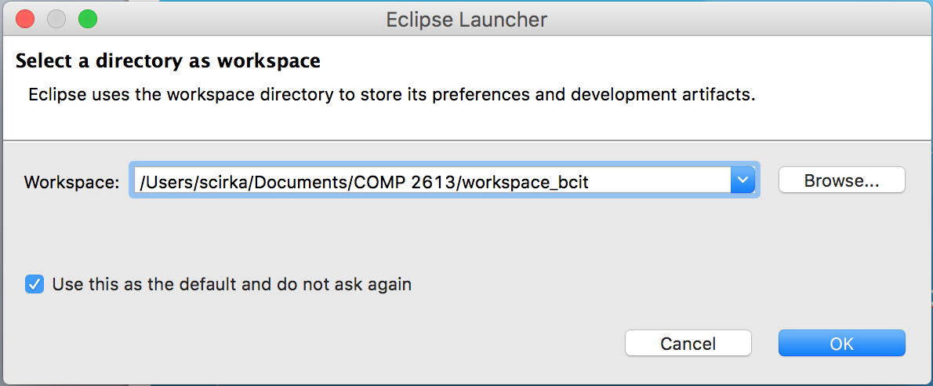
Workspace
You can have multiple workspaces
I have one for BCIT, work, and home stuff
/Users/scirka/Documents/COMP 2613/workspace_bcit

Slide 4
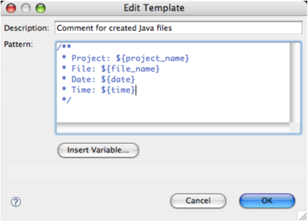
> File Comments
Make sure you have a file comment in all the files you submit
Automatically create file comments
Window > Preferences
Java > Code Style > Code Templates
Comments > Files > Edit…
/** * Project: ${project_name} * File: ${file_name} * Date: ${date} * Time: ${time} */

Slide 5
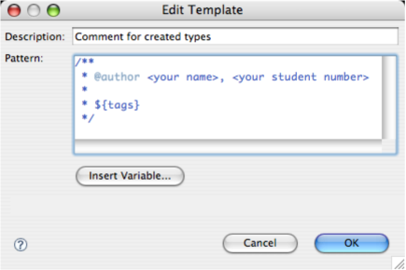
> Type Comments
Automatically create type comments
Java > Code Style > Code Templates
Comments > Types > Edit…
/** * @author Instructor, A00123456 * * ${tags} */

Slide 6
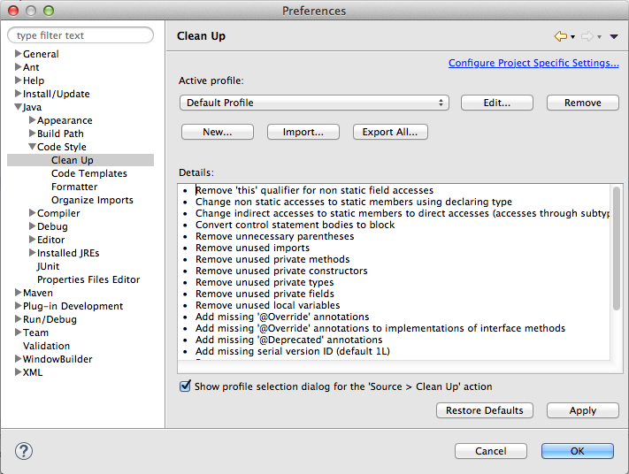
> Code Cleanup
Code Cleanup
Java > Code Style > Clean Up
Import…
Select “My Eclipse Profile.xml” from the week 1 folder

Slide 7
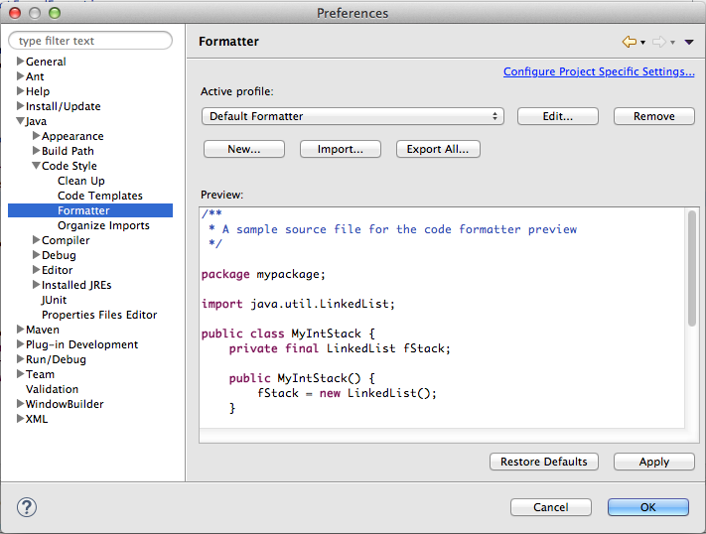
> Eclipse setup
Formatter
Java > Code Style > Formatter
Import…
Select “My Eclipse Formatter.xml” from the week 1 folder

Slide 8
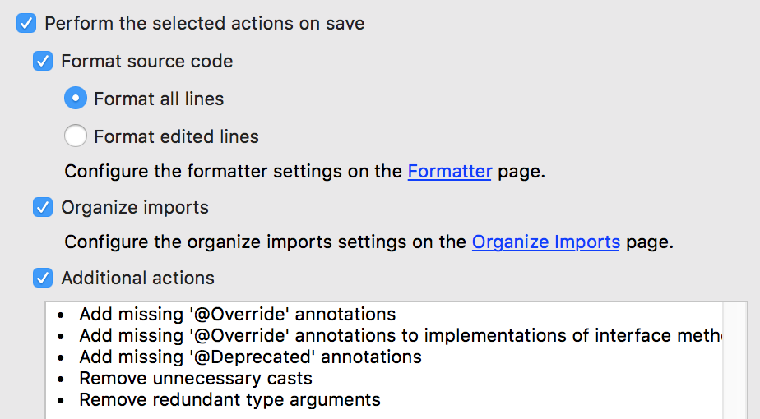
> Save Actions
Java > Editor > Save Actions

Slide 9
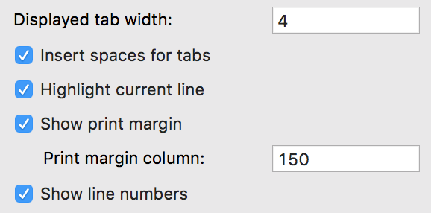
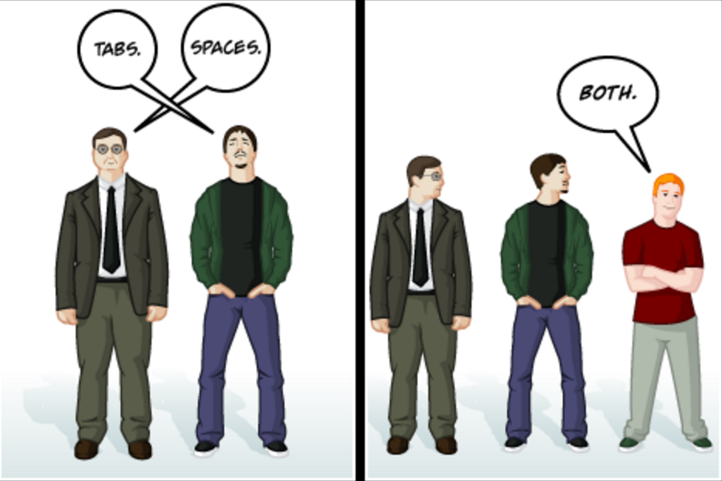
> Text Editor setup
Search for "Text Editors" or General > Editors > Text Editors
Make some changes if you like
Press OK
Be consistent!

Slide 10
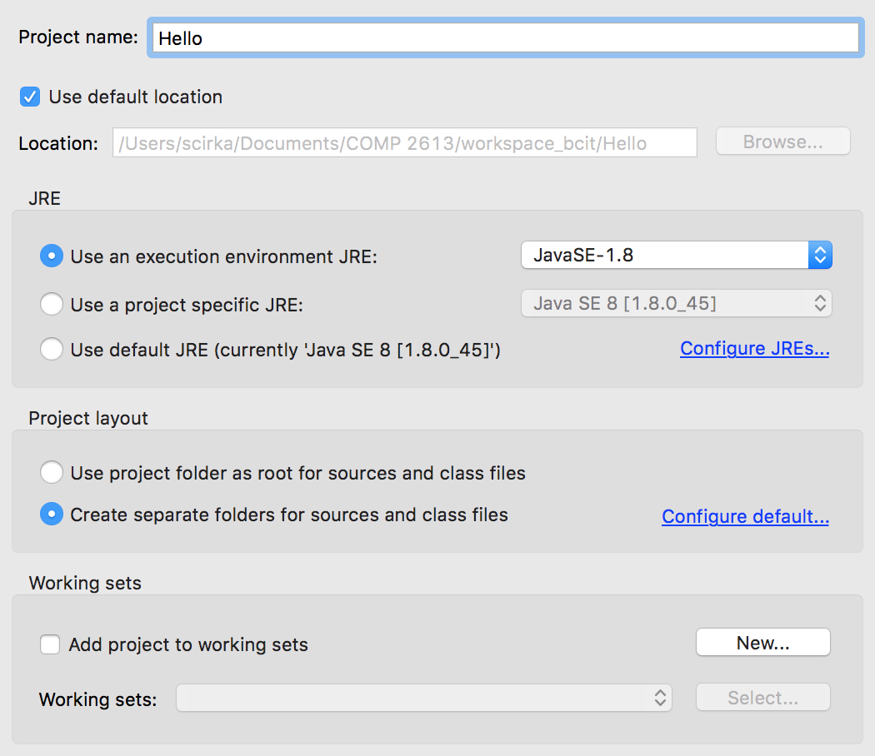

> Creating a Java project
Create a new project
File > New > Java Project…
Use “Hello” for the project name
Leave the defaults
Select “Finish”

Slide 11
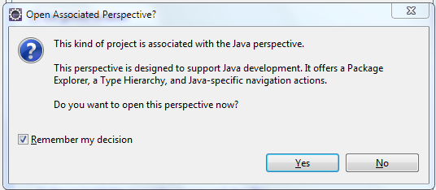
Open Associated Perspective?
If you see the dialog box below after you press “Next”, check the checkbox and press Yes

Slide 12
> Create your main class
File > New > Class…
Leave the package blank
Use “Hello” for the class name
Select…
☑ public static void main(String[] args)
☑ Generate comments
Select “Finish”

Slide 13
> Hello.java
/**
* Project: Hello
* File: Hello.java
*/
/**
* @author Sam Cirka, A00123456
*
*/
public class Hello {
/**
* @param args
*/
public static void main(String[] args) {
// TODO Auto-generated method stub
}
}

Slide 14
> Modify the Hello class
In the main method, replace the TODO comment with:
System.out.println(”Hello Java!");
eclipse automatically compiles your code

Slide 15
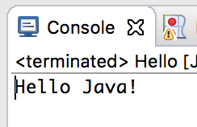
> Run
Run > Run As > Java Application
In the Console Window:

Slide 16
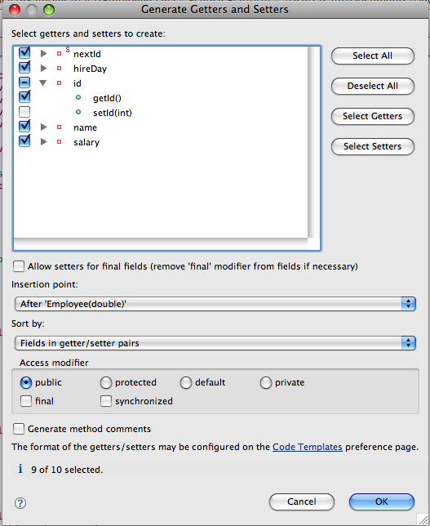
eclipse Tips
You don't need to manually create setters & getters
Select "Source > Generate Setters and Getters”
Or toString
In your class file, open a context menu, then select ‘Source > Generate ToString()…’
All data classes should override toString()

Slide 17
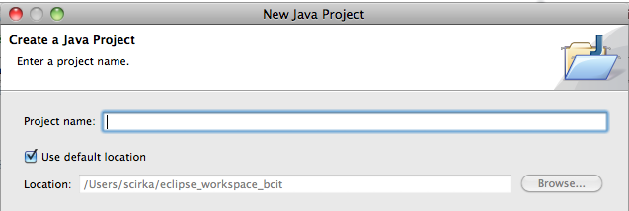
Using The Examples
Select “File > New > Java Project”
Deselect "Use default location”
Point the directory to the examples folder

Slide 18
Coding Standards
The code you submit in this course must follow the Google Java Style located at https://google.github.io/styleguide/javaguide.html

